Slide 1



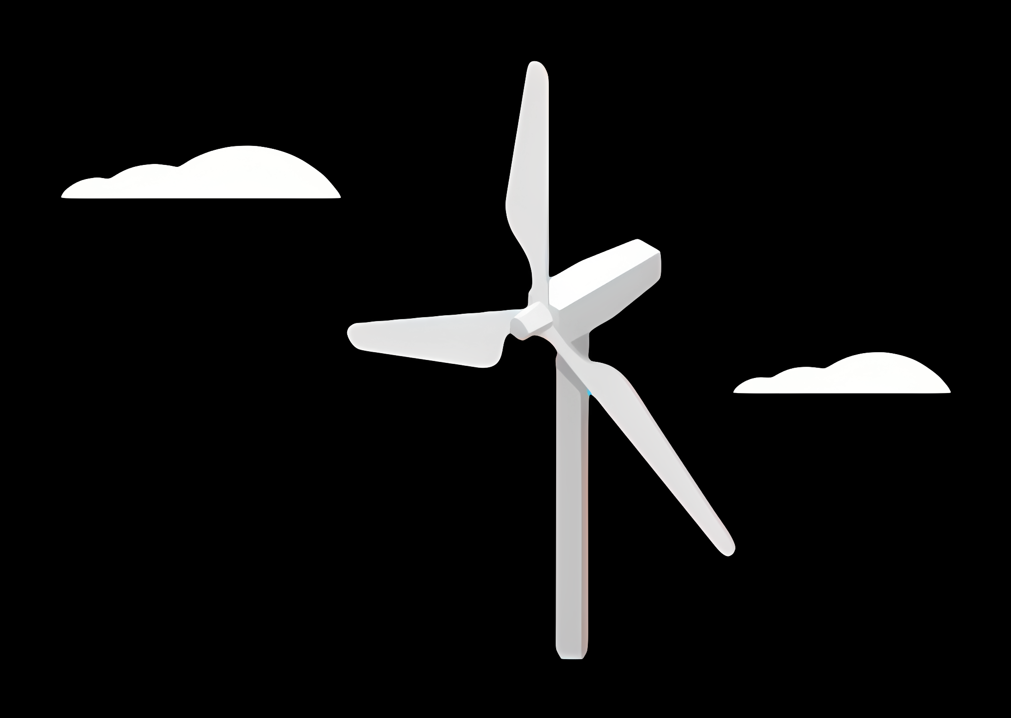
Weekly report: Electrical Drive Train
Group number: 06
Date: 10/09/2025
Supervisor: Prof.Dr.Ing.Rajesh Saiju
Group members: Aiswarya Vijayan, Girish Mahadeo Padalkar, Vishranti Shivajirao Patil, Cristina Milene Vergara Hernández

Slide 2
Tasks of the week
Content
Week 1 : Initial Research & Setup
Initiated research on electrical market in Syria and neighboring countries. [1]
Gathered data on designing Generator, Convertors.
Collect information's from kickoff presentation slide and find out the duties of Electrical Drive Train team.
Studied generator types: PMSG, DFIG, synchronous generators.
Week 2 : Generator Studies
Reviewed paper for criteria for selecting Generator type. [2]
Collected data on the Cost: Economic considerations for energy production.
Performance: Rated power output, annual energy production, and efficiency in Syria. [3]
Technology: Synchronous vs. asynchronous generator.
Compared Generator types ( PMSG & DFIG)

Slide 3
Week 3 : Converter Studies
Studied different types of converters generally used in Wind Turbines, with focus on Syria.
Analyzed functions and classifications of converters in Wind Turbine Technology.
Studied classification and choice of generator-side converter systems. [4]
Started studying MATLAB software and applications.
Outcome: Completed converter analysis and initiated MATLAB learning for simulations.
Week 4 : Generator Research & MATLAB Study
Studied Wind turbine drivetrains: state-of-the-art technologies and future development trends.
Collecting the data’s and doing research on the type of generator which we can use for this project.
Collected data for reactive power capabilities of different Generators.
…

Slide 4
Week 5 : Generator Finalization & Converter Study
Finalized generator type for Optimus Syria Project
Studied converter protection, maintenance, and reliability. [5]
Challenges:
Ensuring chosen generator meets project requirements
Outcomes:
Shortlisted generator type
Week 6 : Concept Finalization
Selected PMSG type generator for Optimus Syria project.
Researched types of converters suitable for the design.

Slide 5
Our Recommendation: PMSG for the Optimus Syria
Why PMSG is the Better Choice:
Reliability is Critical: Given the challenges with local support and part availability in Syria, the PMSG's higher reliability and lower maintenance needs are paramount. This is a crucial factor, especially in a climate with high heat and dust.
Adaptability to Weak Grids: The Syrian electrical infrastructure is facing reconstruction , and the grid is weak. The PMSG's excellent grid control makes it a robust choice that can handle these conditions effectively.
Efficiency and Durability: PMSG generators meet the preferred efficiency standard of over 90% for grid-connected systems. Their durable design is well-suited to the local climate.
Long-Term Financial Viability: While the initial cost may be higher , the long-term benefits of reduced maintenance and higher efficiency will lead to a more sustainable and economically sound project.

Slide 6
Bibliography
[1] S. Hatahet and K. Shaar, “Syria’s Electricity Sector After a Decade of War: A Comprehensive Assessment,” https://cadmus.eui.eu/, Jun. 30, 2021. https://cadmus.eui.eu/server/api/core/bitstreams/c78454ff-21c8-5b4f-8b38-6aec738fa0d7/content
[2] K. Stuhrmann, “Generator Selection - LuvSide GmbH,” LuvSide GmbH, Feb. 16, 2024. https://www.luvside.de/en/generator-selection/
[3] Al Jamil and G. Sidorenko, “Syria’s wind resources: Outlook for the Future,” E3S Web of Conferences, vol. 157, p. 06032, 2020, doi: https://doi.org/10.1051/e3sconf/202015706032.
[4] Abdeldjalil Dahbi, Nasreddine Nait-Said, M. Hamouda, and F. Z. Arama, “Analysis of different converters used in wind energy conversion system,” Mar. 12, 2015. https://www.researchgate.net/publication/282928746_Analysis_of_different_converters_used_in_wind_energy_conversion_system
[5] K. Fischer et al., “Reliability of Power Converters in Wind Turbines: Exploratory Analysis of Failure and Operating Data From a Worldwide Turbine Fleet,” IEEE Transactions on Power Electronics, vol. 34, no. 7, pp. 6332–6344, Jul. 2019, doi: https://doi.org/10.1109/tpel.2018.2875005.
‌
‌
‌
‌
“How HOMER Calculates Wind Turbine Power Output,” Homerenergy.com, 2017. https://www.homerenergy.com/products/pro/docs/3.15/how_homer_calculates_wind_turbine_power_output.html (accessed Aug. 25, 2025).
Source 2:
Source 3:
…

